Slide 1


AR
IN EDUCATION

Slide 2



OUR TEAM MEMBER
RAJEEV PAUDEL

Slide 3



WHAT IS AUGMENTED REALITY (AR) ?
It is a technology that combines computer-generated elements with the real world.
It's like putting virtual things in the real world to make it more fun and interesting.

Slide 4


BENEFITS OF AR IN
EDUCATION
Enhanced Engagement
Visualizing Complex Concepts
Overcoming Resource Limitations

Slide 5
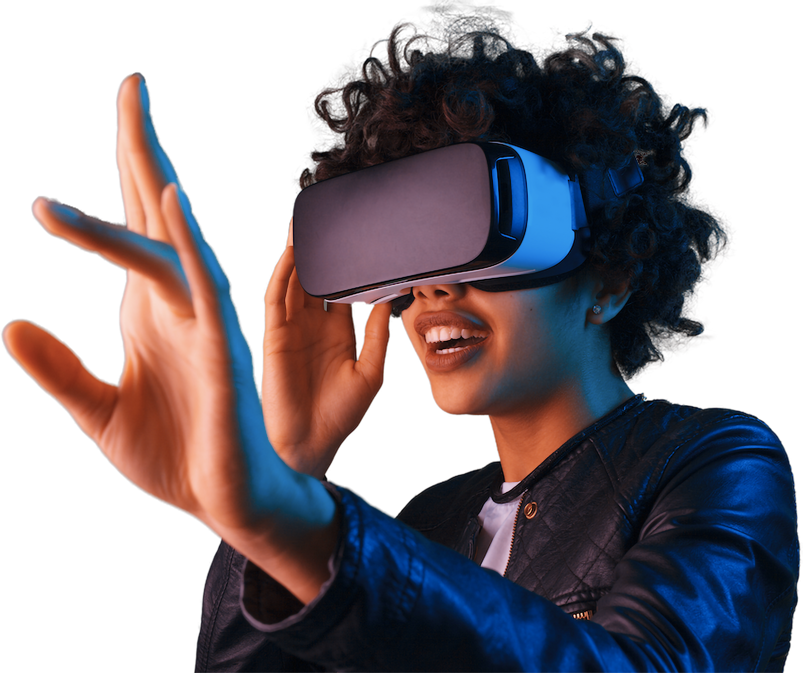

AR USE CASES IN NEPAL

Slide 6

Virtual Field Trips:

Slide 7
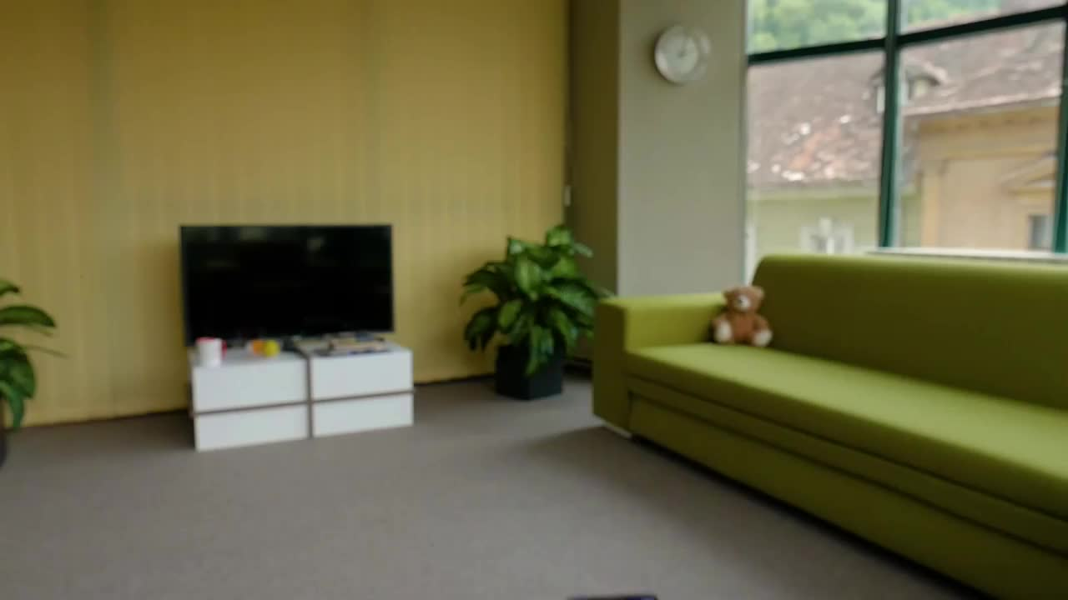
Language Learning:

Slide 8
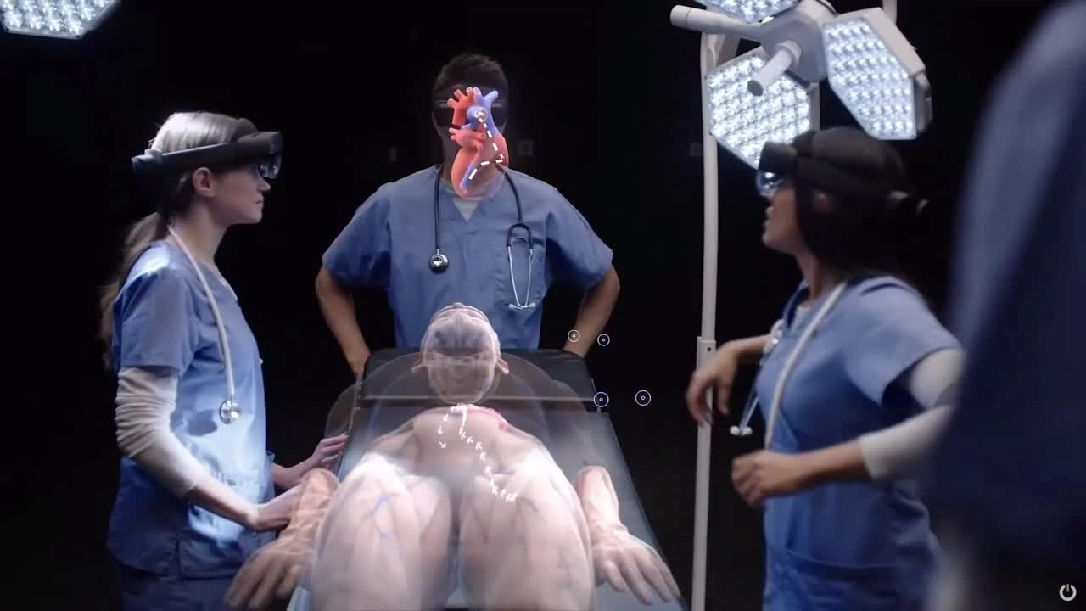
Science Experiments

Slide 9
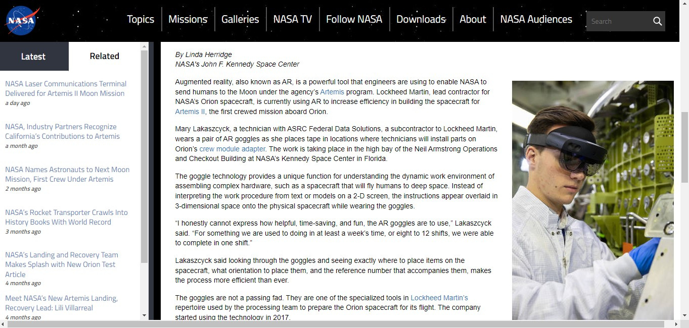

Slide 10

IMPLEMENTATION CHALLENGES
Technological Infrastructure

Slide 11


TECHNOLOGY USED
AR glasses
Smartphones & Tablets

Slide 12
CONCLUSION
Augmented Reality (AR) revolutionizes education in Nepal.
AR enhances engagement, visualization, personalization, and accessibility.
Let's seize the opportunities and transform education in Nepal through AR!

Slide 13


THANK YOU

